Slide 1
Land Use Management driver database
Michael Wögerer, IIASA

Slide 2
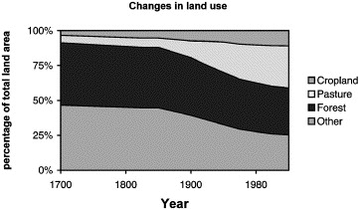
Land use change in general
Substantial change since ~1850
We see:
moderate growth of cropland
massive growth of pasture
both at the expense of forests and other lands
Fig. 1. Estimated changes in land use from 1700 to 1995 (Goldewijk and Battjes, 1997).

Slide 3
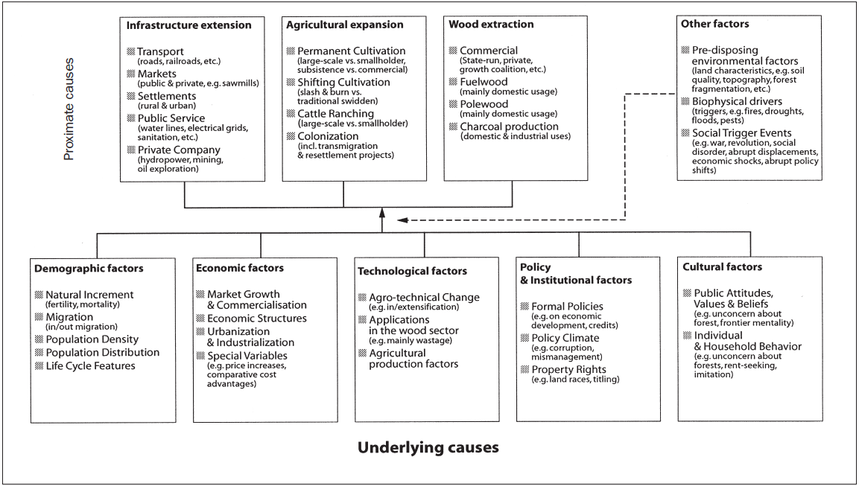
What drives land use management change?
Classifying causes/drivers of land use change is of multidimensional nature
Proximate vs. underlying
housing vs. pop growth
Local vs. global
Soil conditions vs. techn. progress
Economic vs. non-economic
GDP vs. soil conditions
Intentional vs. unintentional
Food prod vs. natural disturbances
Quantitative vs. qualitative
Market size vs. property rights
Fig. 2. Proximate vs. underlying drivers (Geist and Lambin, 2002).

Slide 4
Location factors vs. intensity factors
Intensity rather than location:
Population (#, structure)
Gross domestic product (GDP)
Prices (import, export, consumer, producer)
Trade (restrictions, subsidies)
Location rather than intensity:
Climate data (precipitation, temperature)
Economic data (employment, human capital, sectoral composition)
Biophysical data (Elevation, Slope, Soil)
Agricultural data (FADN, farm structure)

Slide 5
Working with the LUM driver database

Slide 6

Accessing the data?
Data is derived from publicly available data sources and harmonized to the LAMASUS NUTS regions.
Easy to use and merge between the sources.
https://zenodo.org/communities/lamasus/records?q=&l=list&p=1&s=10&sort=newest

Slide 7
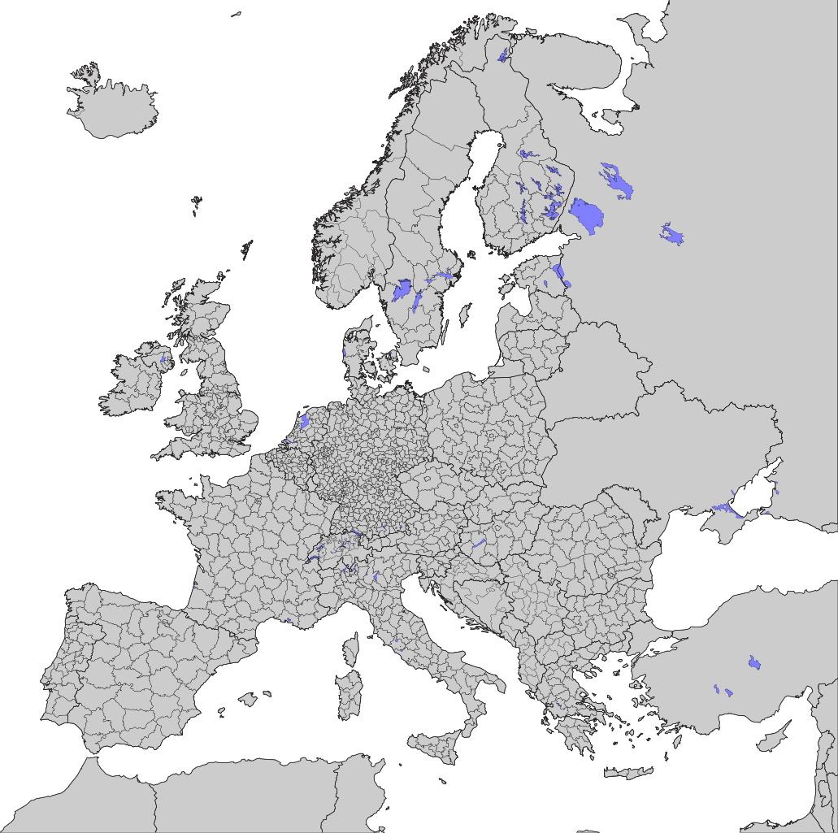
At what regional detail?
The NUTS (Nomenclature des unités territoriales statistiques) is a standardized regional classification used by the EU for collecting and comparing regional statistics.
Blessing in disguise:
Updated on a 3-year period to reflect the changing nature subnational entities.
4 different levels (country, states, provinces, districts)
LAMASUS tries to harmonize to 2016 version

Slide 8
What is available?
Climate Data (Monthly, NUTS)
Precipitation (pr): kg/m²/s
Max Temperature (tasmax): °C
Min Temperature (tasmin): °C
Biophysical Data (Static, NUTS)
Elevation: Mean height above sea level (m)
Slope: Mean slope (degrees)
Aspect: Orientation (degrees)
Topsoil Properties (0–20cm)
% share of USDA textural classes (clay, silt, sand)
FADN-Based Farm Typology Data (Annual, NUTS)
Weighting: Number of farms represented
SE Variables: Standard economic variables (e.g., output, input costs, subsidies)
Detailed variable definitions: variable_description_zenodo.xlsx
Economic & Demographic Data (Annual, NUTS)
Employment by Sector:
empHour_: Hours worked in 1000h
emp_: Employment in 1000 jobs
empl: Total employment
Economic Output:
gdp: GDP (2015 constant prices, mio EUR)
gva_: GVA by sector (mio EUR)
Workforce & Population:
labour: Labour force in 1000 jobs
pop: Total population
Wages:
wage_: Compensation by sector (mio EUR)
Education Shares:
loweduc, terteduc: % of low/high education (NUTS1/NUTS2 only)

Slide 9
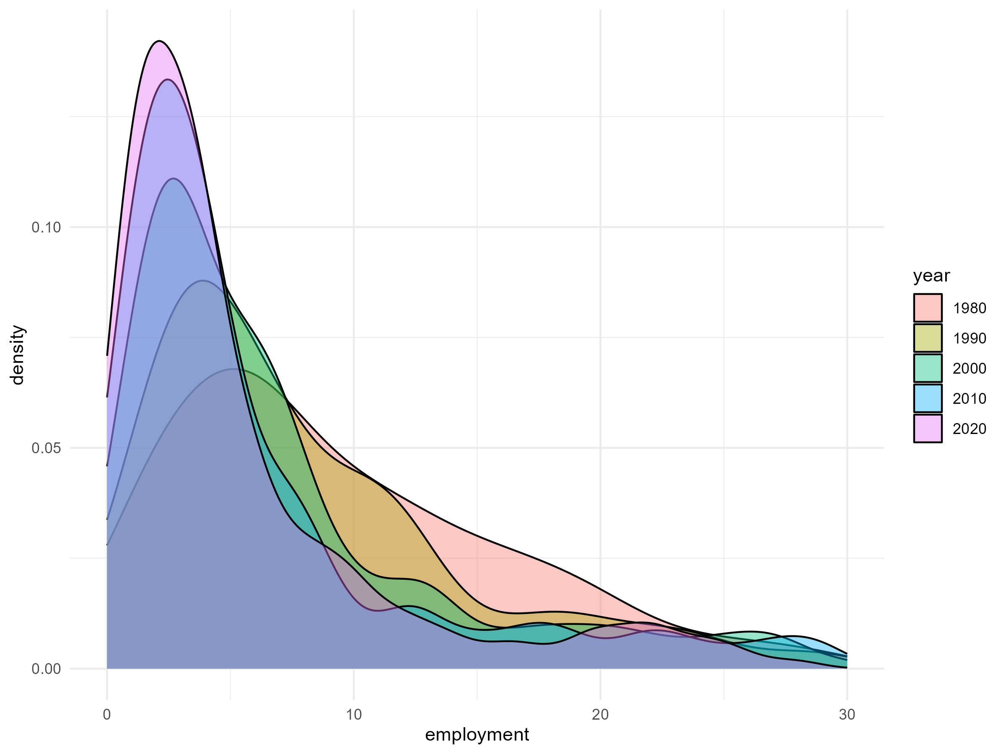
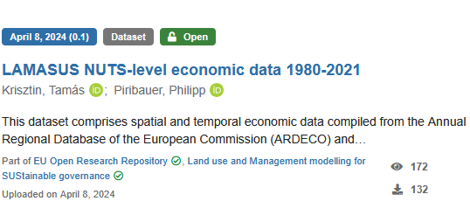
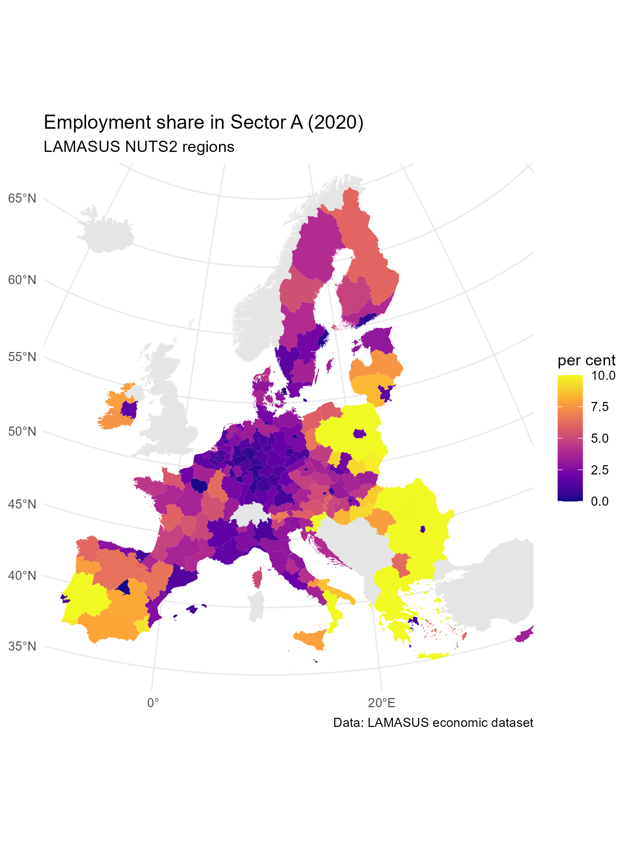
A quick guide from…
…here… …to there.
Git repository – github.com/michidoubleu/LAMASUSSS

Slide 10
What do I need to work with R?
R – The base programming language. It handles the core functionality like computations, data structures, and statistical modeling.
RStudio – A user-friendly interface (IDE) for writing and running R code. It includes helpful tools for script editing, plotting, and managing your environment.
Packages – Add-ons that extend R's capabilities. Examples: tidyverse for data manipulation and plotting, mlogit for discrete choice models.
A dataset – You'll need data to analyze. This could be a CSV file, Excel spreadsheet, or a built-in dataset from R packages.
Basic coding mindset – Willingness to experiment, troubleshoot, and learn by doing. R is beginner-friendly but rewards curiosity.

Slide 11

Please provide your feedback!
https://www.menti.com/alavbf5ep7y3

Slide 12
Thanks for your attention!
Any Questions?

